Slide 1
Personalized Ad- Analytics for small businesses

Slide 2
Problem Statement
Necessity of Market Analytics for Small scale businesses due to the emergence of Tech giants
Personalized adverts to a diverse range of people
How are your marketing activities performing?
What can be done to improve them?
Cost effective advertising
Classification models to predict if a customer chooses to use an offer in the future campaigns

Slide 3
Tools
Python 3.7
Pandas - Data frames
Sklearn – Models
Matplotlib & Seaborn- Data visualization
Jupyter Notebook
Google Collab

Slide 4
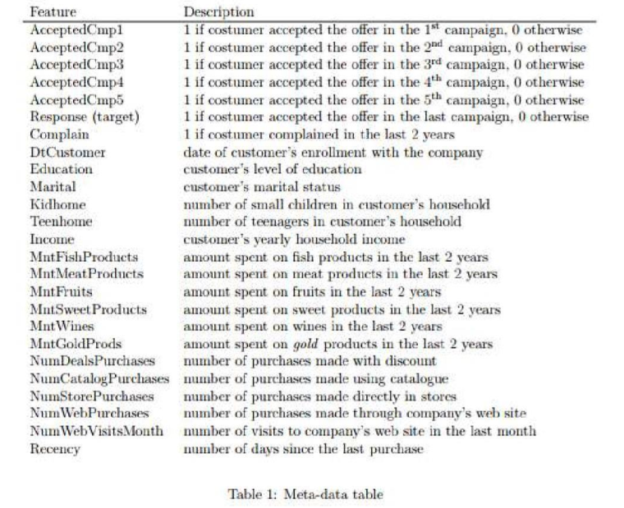
Data Sources
Kaggle - Kaggle | Marketing Analytics
Information related to customer and their purchases over 3 years from 2012- 2014. There are 28 features and about 2300 tuples.

Slide 5
Data Pre-processing
String Manipulation
Income Feature
Categorical to Ordinal Feature Conversion
Marital Status
Education
Date related Conversions
Year of Birth to Age
Customer joining date to Number of customer days till today
Missing Value Imputation of Income Column using Median as mean and median are almost equal for the attribute and median is robust to outliers.
Data entry errors (noise) in Year of birth attribute, 3 tuple are removed from dataset.

Slide 6
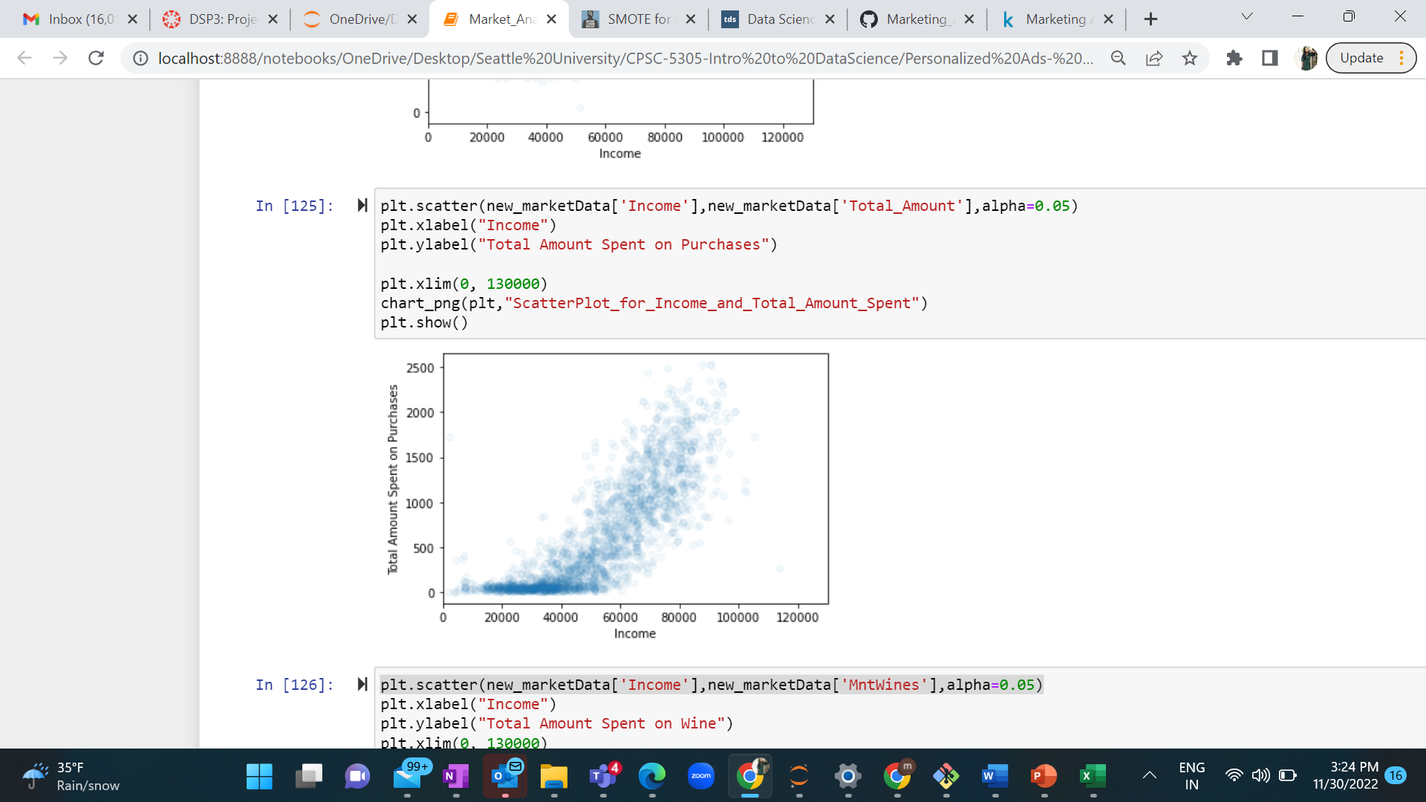
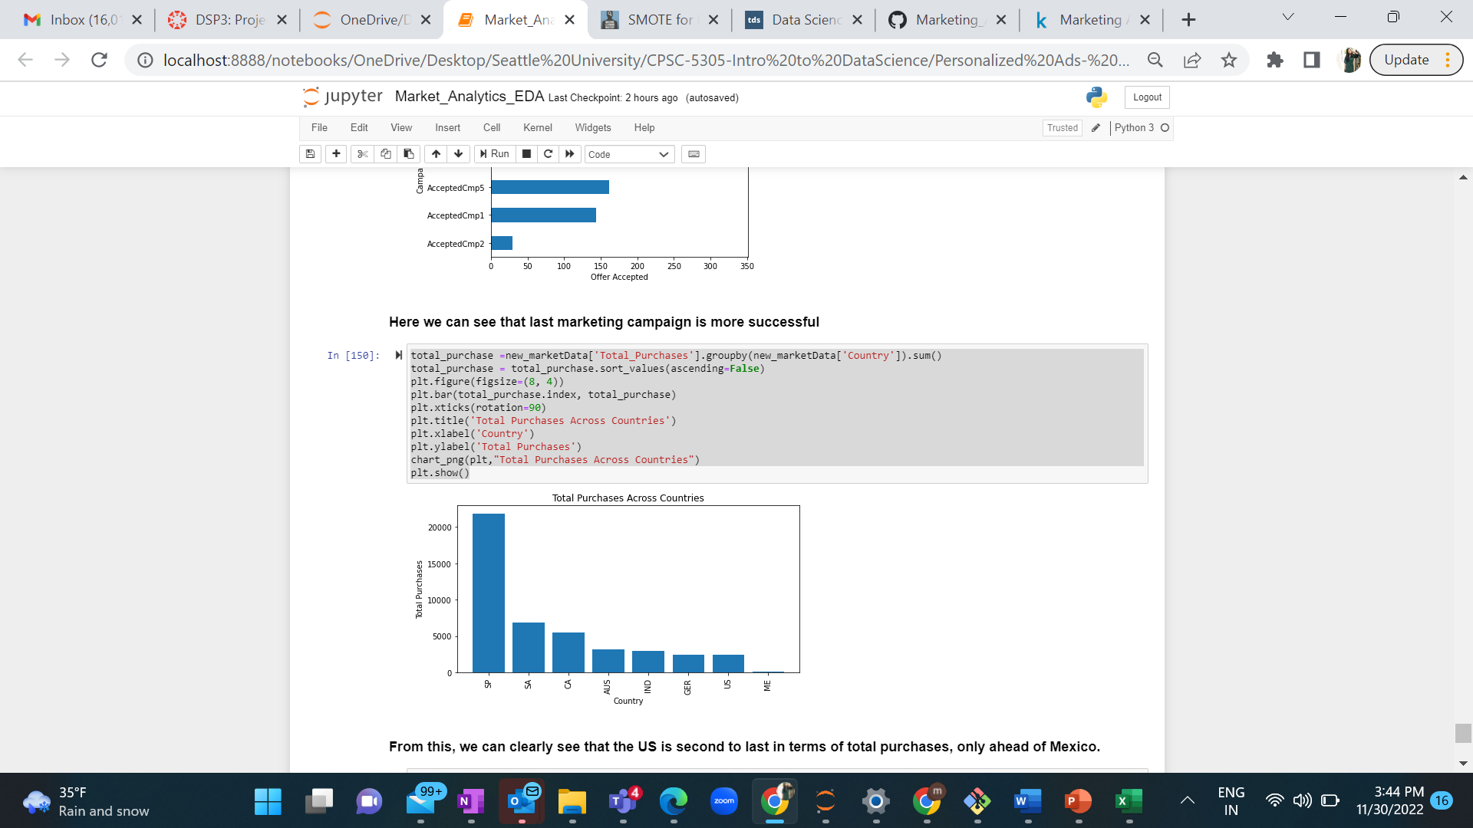
Exploratory Data Analysis
Descriptive statistics
Correlation Analysis
Analysis of Total Amount spent on Purchases with respect to Income
Analysis of Total number of purchases with respect to Countries

Slide 7
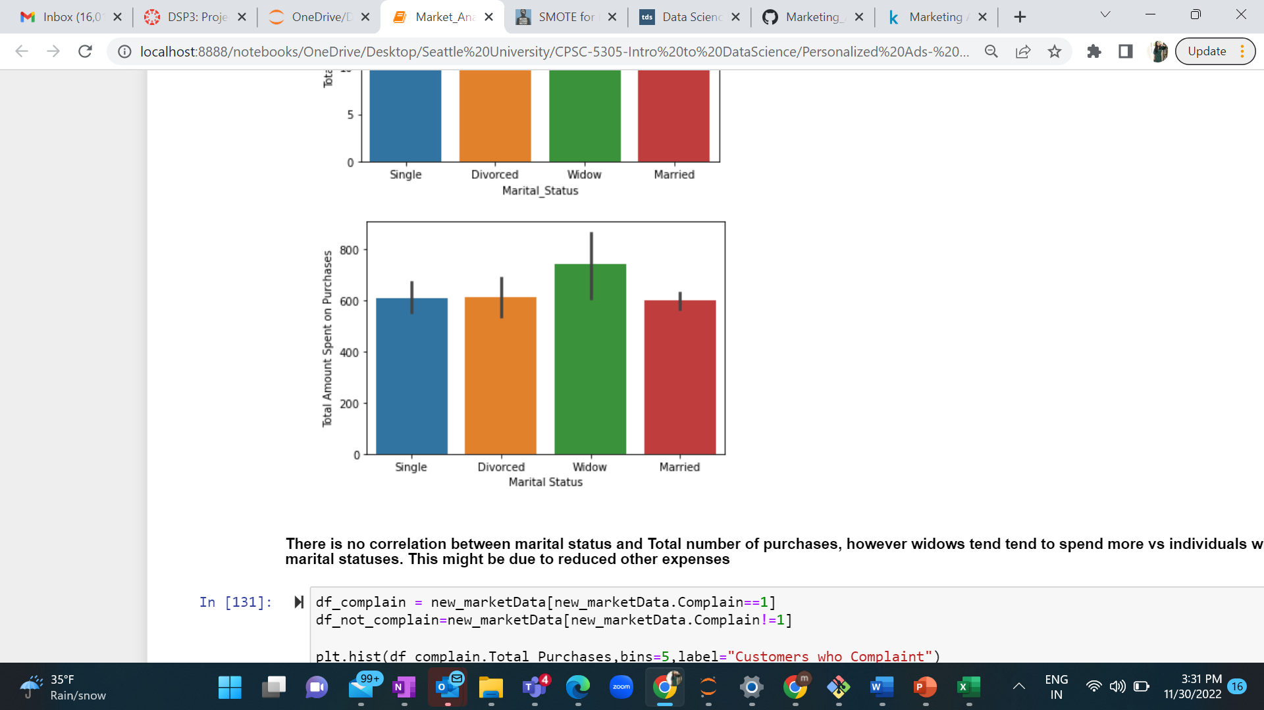
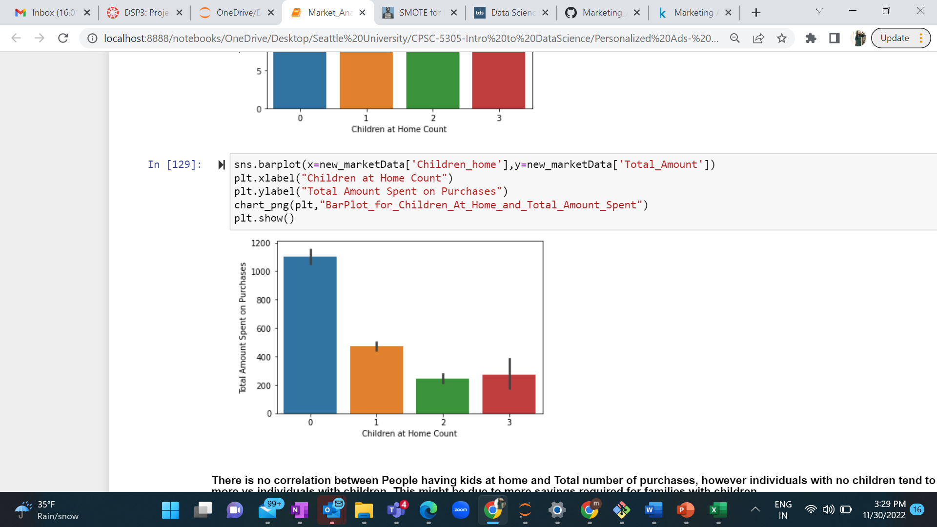
Analysis of Total Amount spent on purchasing with respect to children count
Analysis of Total Amount spent on purchasing with respect to Marital status

Slide 8
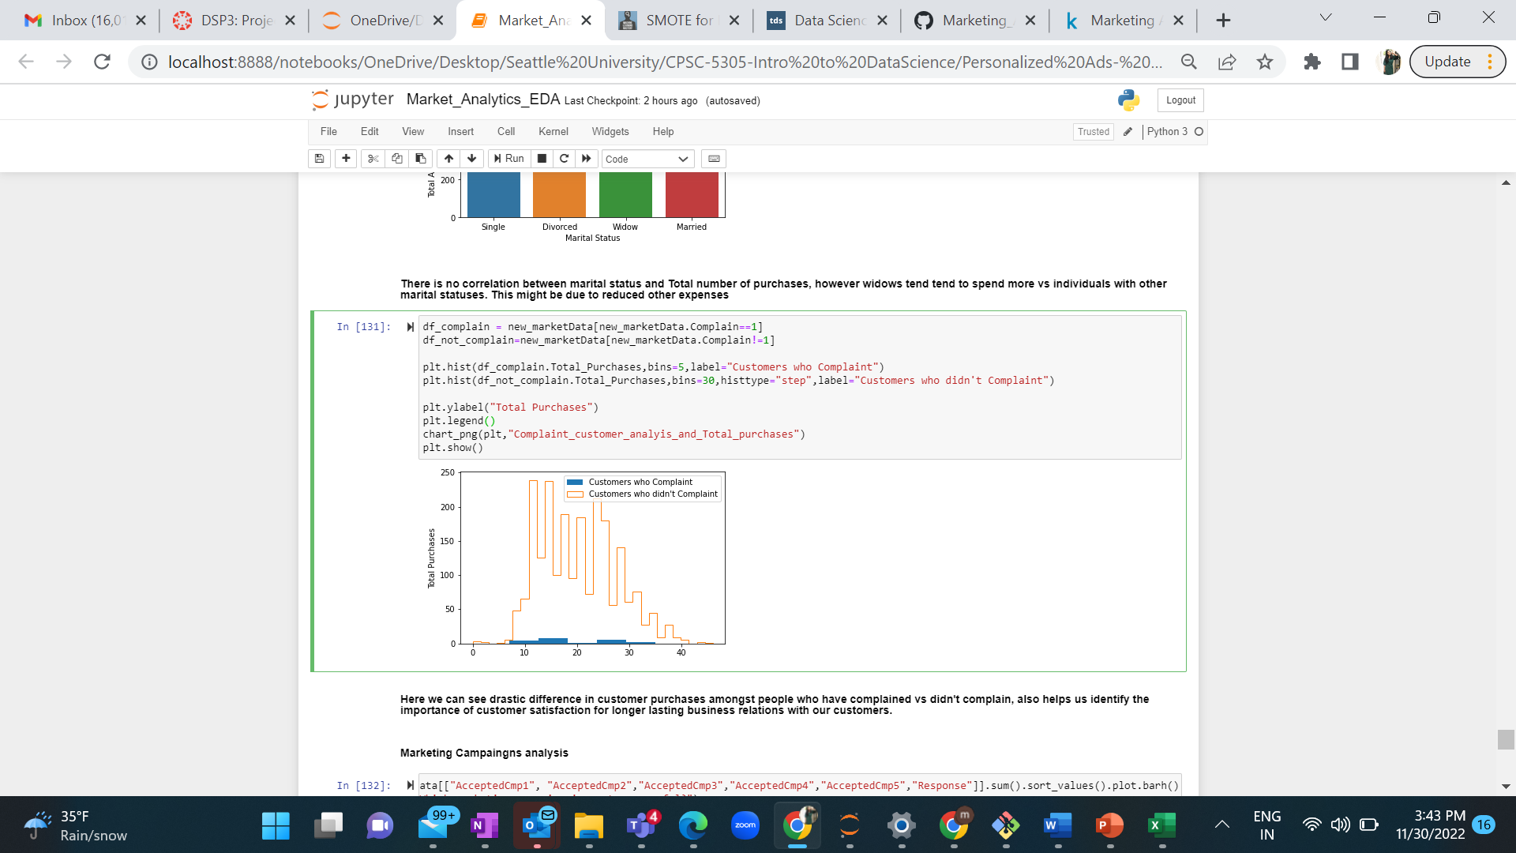
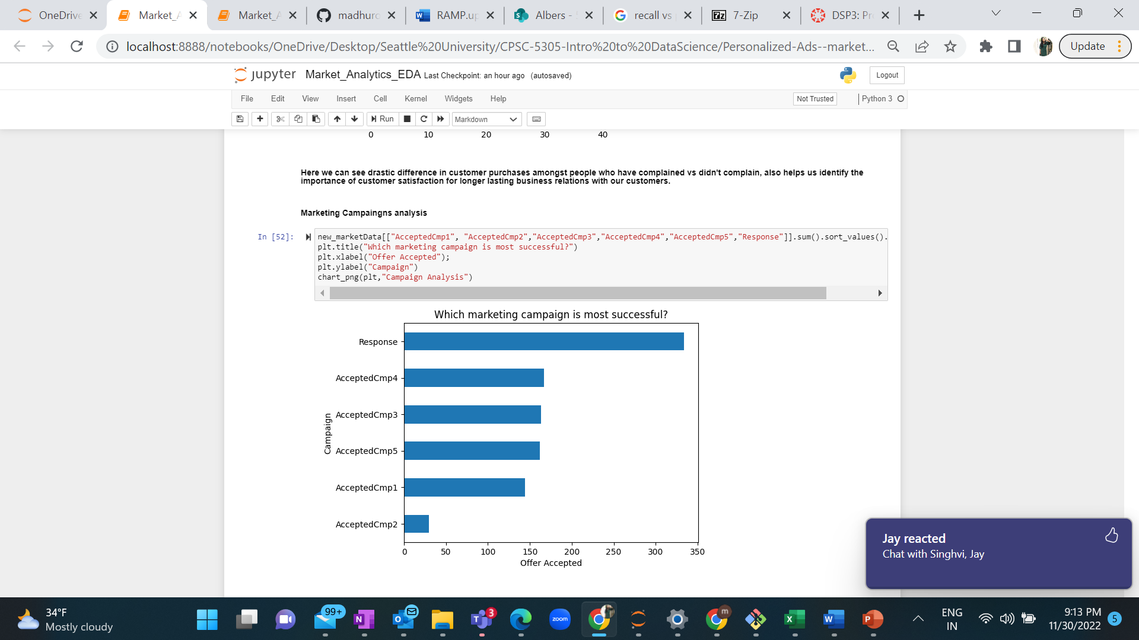
Analysis of Total number of purchases with respect to Customer Complaints
Marketing Campaign Analysis

Slide 9
Class Imbalance problem, as number of 0’s (People who did not accept the offer) are more compared to 0’s (People who accepted the offer
Prepared the dataset, Using SMOTE (Synthetic Minority Oversampling Technique) to oversample the minority class and then use Random under sampler to under sample the majority class
Used Supervised learning, classification algorithms such as Decision Tree, KNN and Random Forest classifier to predict the response variable
Data Preparation and Modelling

Slide 10
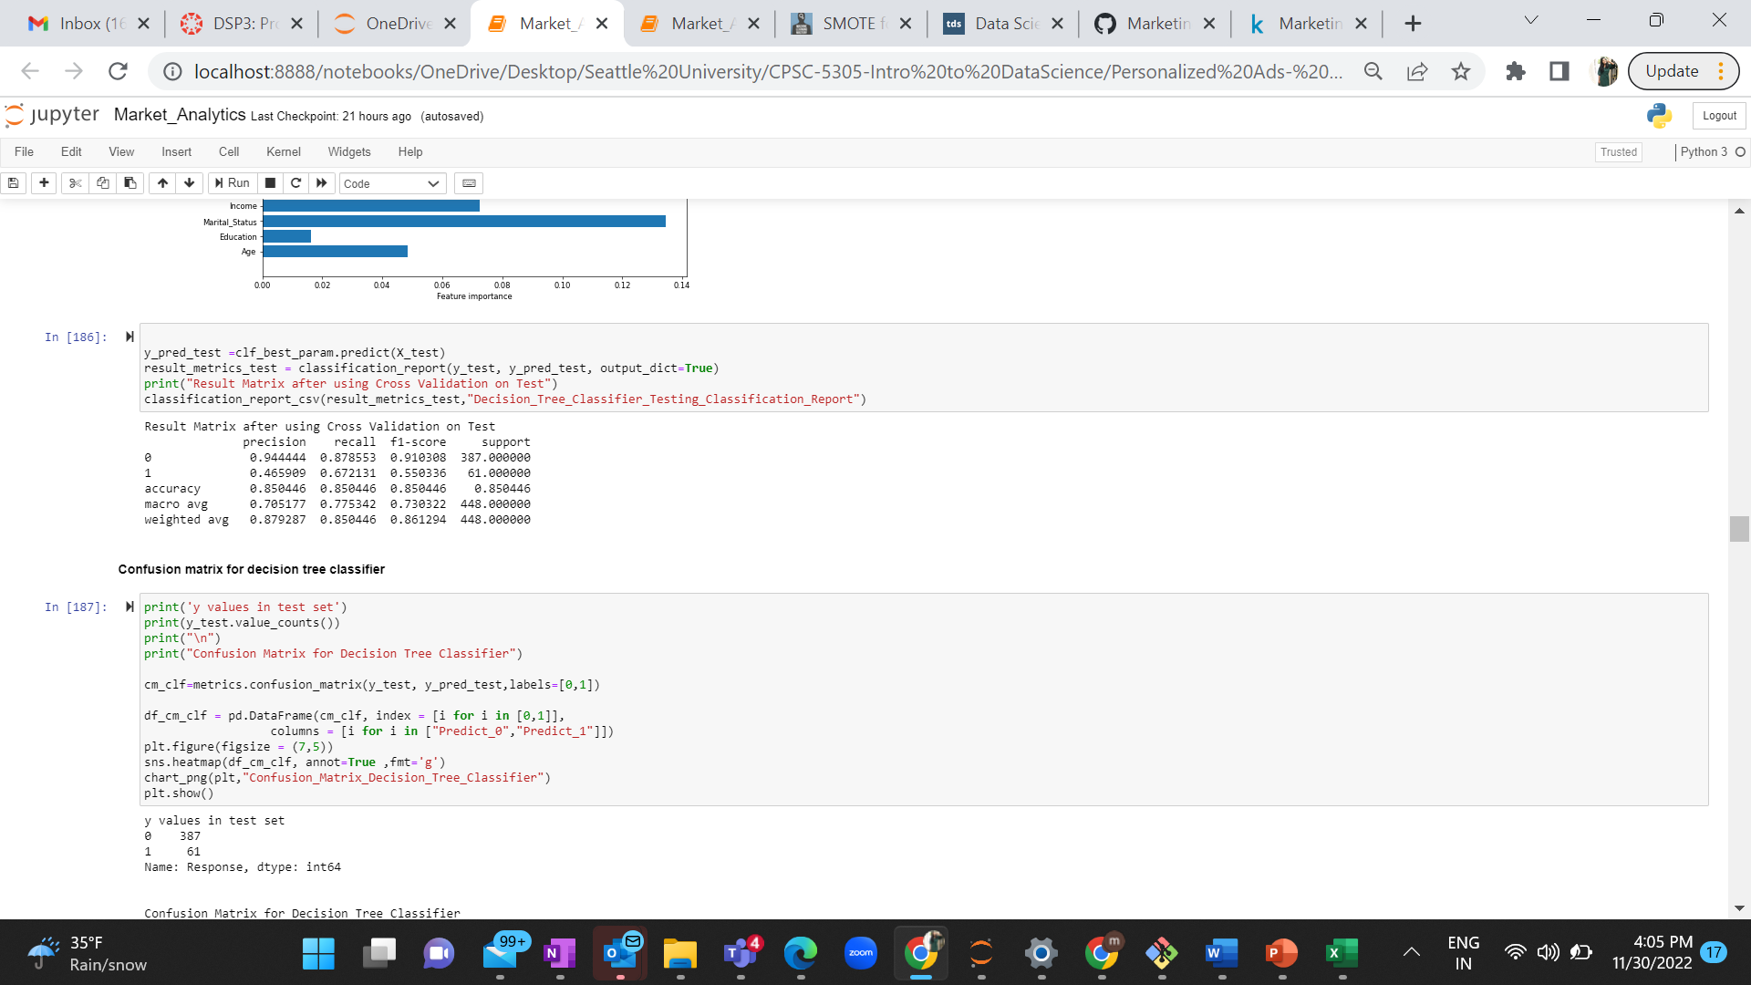
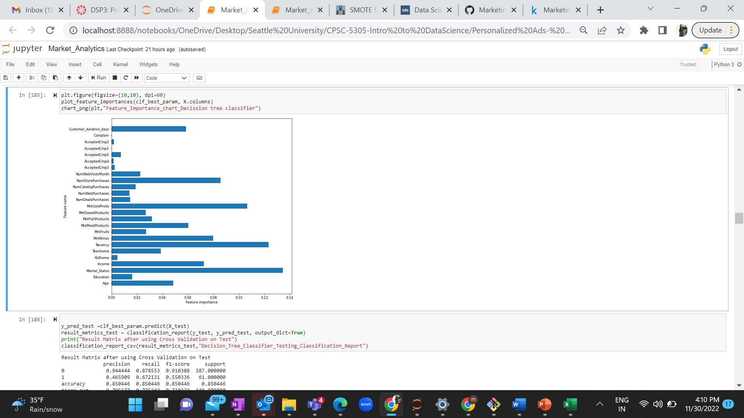
Decision Tree Classifier
Cross validation
Hyper parameter tuning- Criterion, entropy and depth is 17
Accuracy- 85%
Feature Importance graph

Slide 11
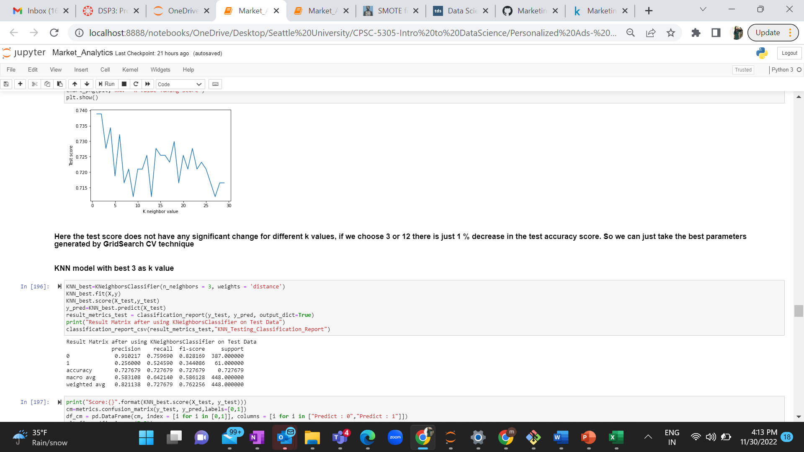
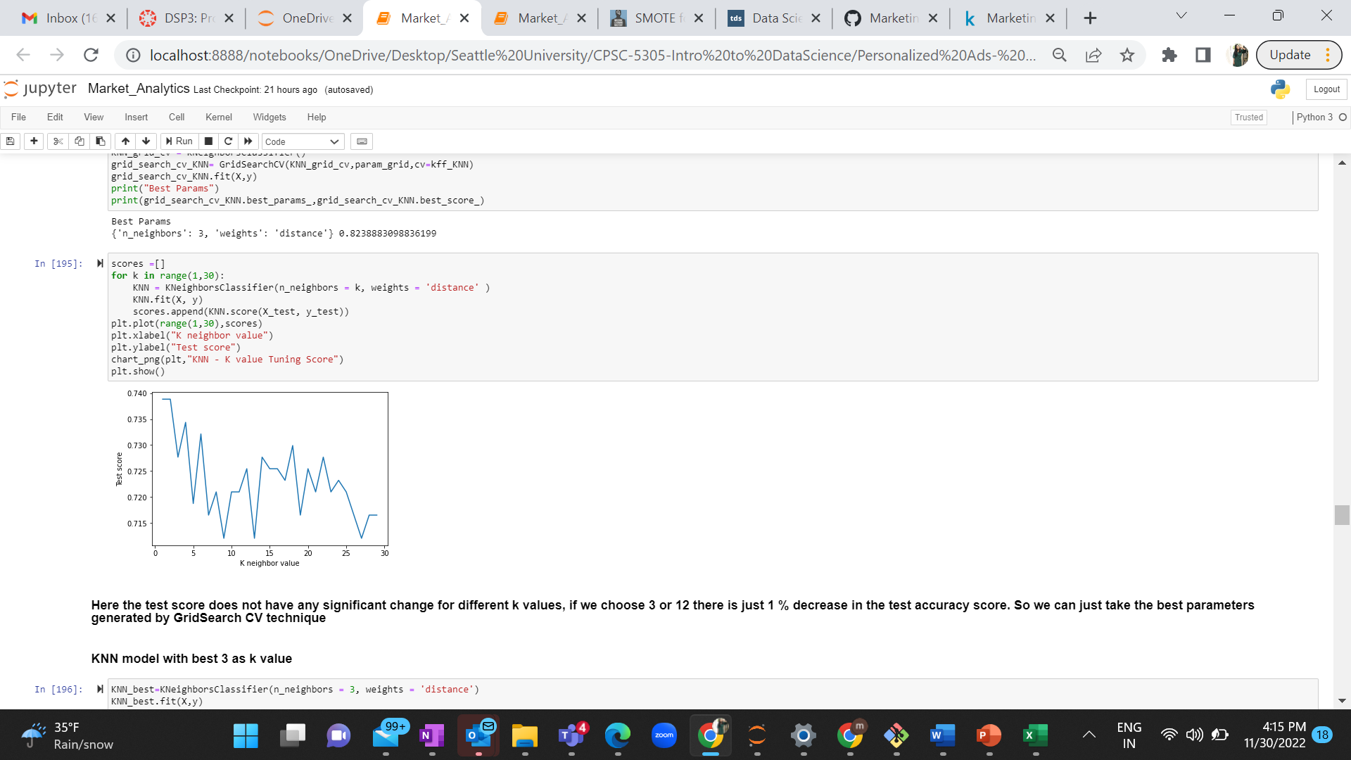
KNN
Cross validation
Hyper parameter tuning, k =3
Accuracy- 72%
Accuracy score of Test data analysis with respect to different k values

Slide 12
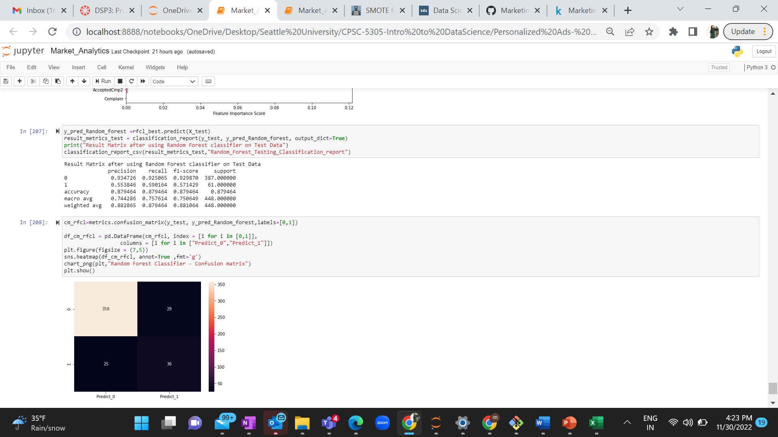
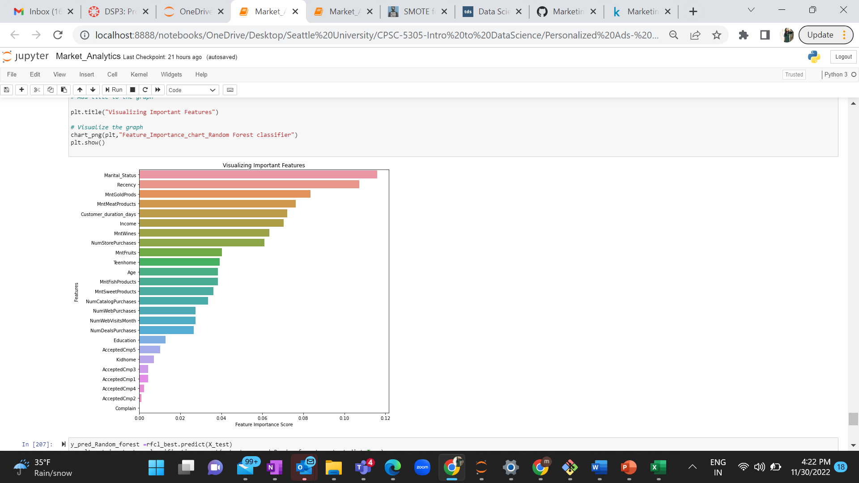
Random Forest Classifier
Cross validation
Hyper parameter tuning, n estimators=90, criterion = gini, max depth = 16
Accuracy- 88%
Feature Importance graph

Slide 13
Model analysis
KNN performance was very low with an accuracy of 72%
Decision Tree Classifier gave an accuracy of 85%
Random Forest Classifier performed well with an accuracy of 88% higher than other models
Feature Importance using Random Forest-
Marital Status, Recency, wine, meet and gold purchases, Income, Number of store purchases, Number of web purchases, Number of Catalog Purchases are some of the important features for predicting the response variable
Summary

Slide 14
Followed the Data science methodology
Data Collection
Generated a Problem statement
Data pre-processing
Data Analysis
Data Preparation and modelling
Things that can be implemented in future
We can use unsupervised learning, to cluster the data set into groups. Marketers might use it to determine if people purchasing a specific product have a similarity that can be identified and then targeted in the future.
Conclusion

